Slide 1


ROBOVERSE DRONE CHALLENGE

Slide 2
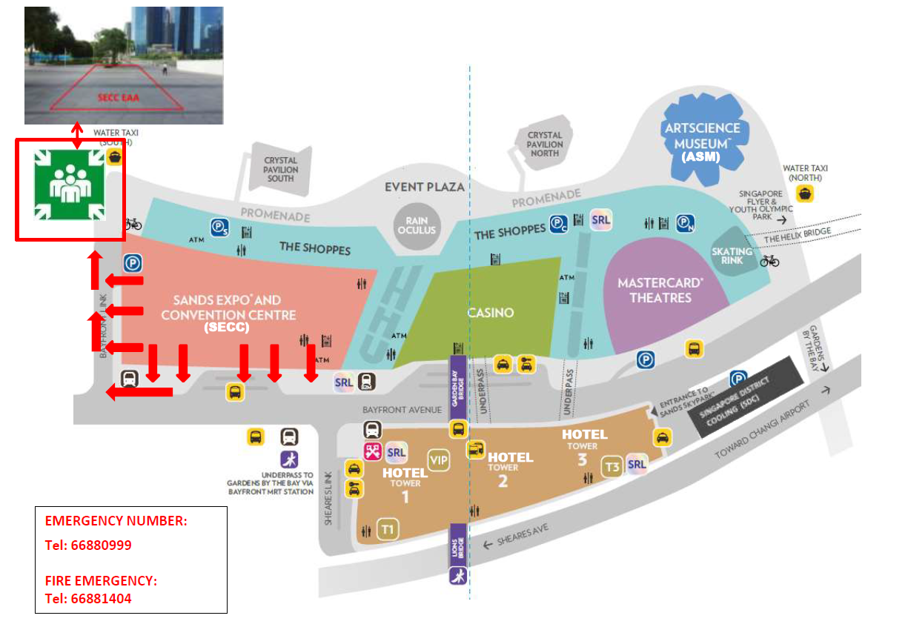
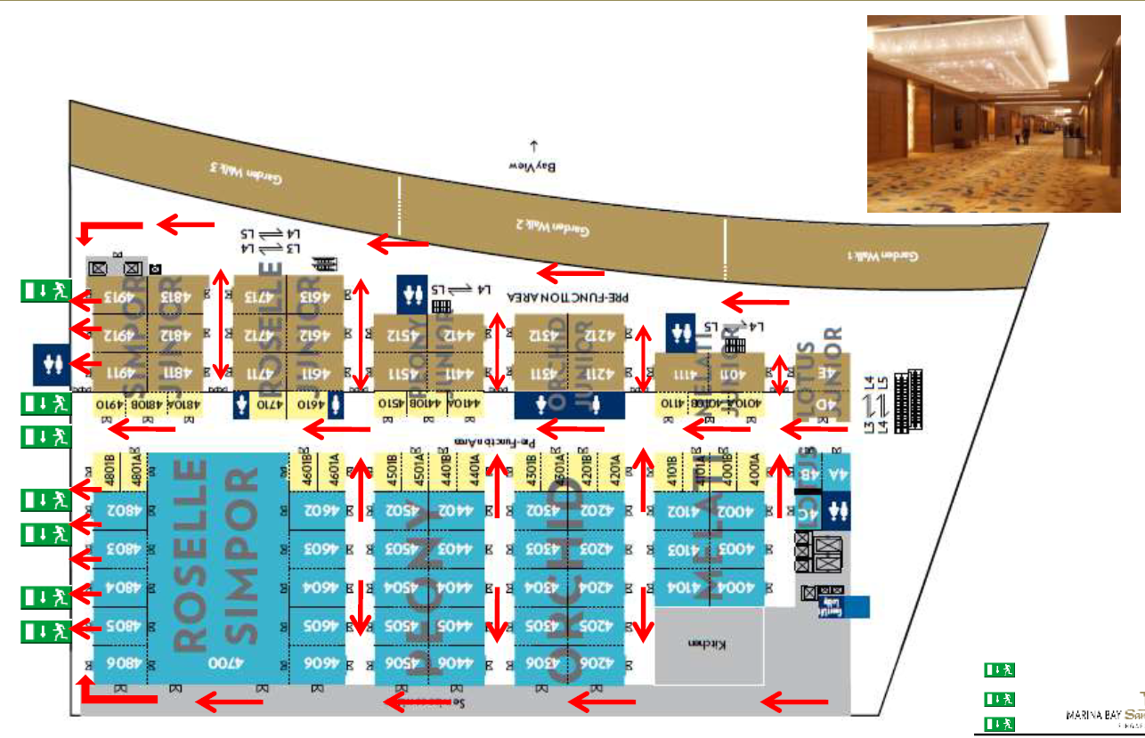
EVAC route
SuperAI
Conference
Xrperience
CODE_EXP
Pico
DSTA
InfraXCode
Media
VIP Room
Spacecube
Swag
MAIN
STAGE
TECH
SHOWCASE
CDDC
Roboverse
TIL_AI
First aid
Sentinel
MBS L4 layout
MBS L1 assembly point

Slide 3

Final Competition
Scenario
Your team receives intelligence of the enemy’s transport convoy travelling routes. Your mission is to gather information on the convoy.
Objective
To eliminate all targets of the convoy.
Challenge
The challenge will be carried out in 2 stages:
Reconnaissance (University teams only) [Stage 1]
Deployment & Ambush [Stage 2]

Slide 4
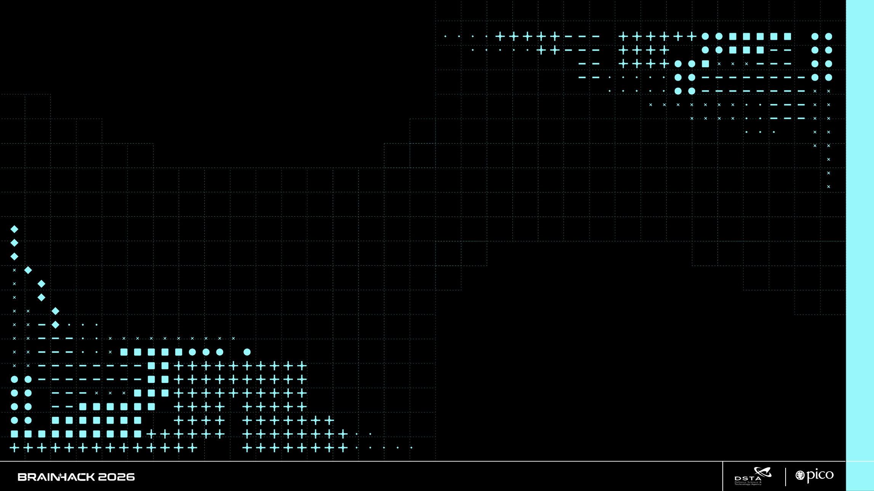
CHALLENGE STAGES

Slide 5
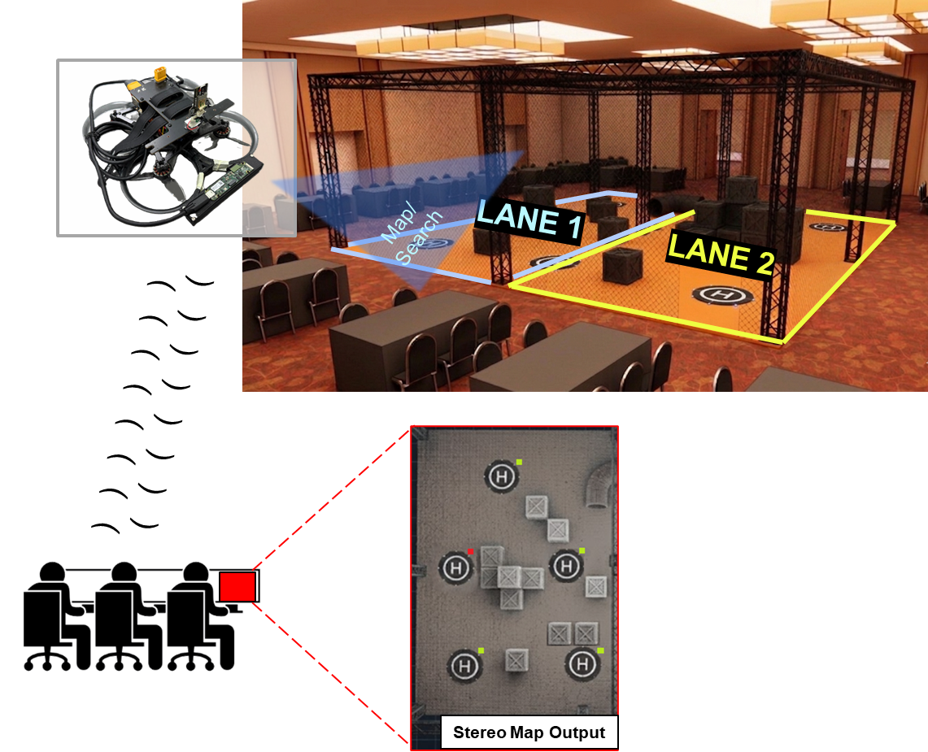

Challenge One (University teams Only)
Maximum: 8mins
Gameplay
A Mapping Drone with Stereo Camera will be deployed to map the arena.
The arena comprises obstacles and 5 Drone Landing Pads, each attached with an Aruco Marker.
The Mapping Drone will return a top-down depth map, and images of the Aruco Marker.
Before the assessment starts, the valid and invalid Aruco Marker IDs will be announced. Teams are expected to decipher the Aruco Marker to check if each landing site is valid for landing.
Teams will have to output and annotate the Aruco markers (see bottom right for example).
Other Rules
Maximum speed for Mapping Drone: 0.3m/s
Evaluation Criteria
Teams will be awarded points based on their understanding of the concept, mapping speed, and the accuracy of identifying landing sites as valid or invalid.
To note
The landing pads for the assessment will have a different configuration compared to the test set-up.
1x Mapping Drone
(Intel Realsense Stereo Camera)
5.88Ghz Control +
Footage
ID number
Participants’ C2 Terminal
Aruco Marker Placed Beside Landing Pad

Slide 6
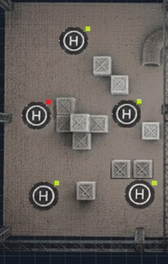
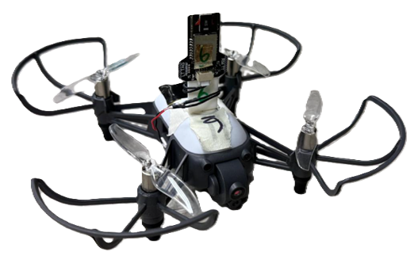

Challenge Two
Maximum: 8mins
Gameplay
Refer to Discord for the coordinates of valid landing points.
Using the provided coordinates, the team will select 3 out of 5 available landing zones.
Then, they will launch 3 HULA drones from the Command Centre (C2) to land on the designated areas in preparation for an ambush.
Other rules
For the HULA drone: Strictly no flying over obstacles. The recommended height is 1.1m. Any team found to violate this will have their scores invalidated.
Maximum speed for HULA drone: 0.5m/s
Evaluation Criteria
Points will be awarded for successful and accurate landings on the designated zones, in the least amount of time.
Land
3 x Highgreat HULA Drones
Land
) ) ) ) ) ) ) )
) ) ) ) ) ) ) )
Land
Participants’ C2 Terminal
Invalid Landing Zones
Valid Landing Zones

Slide 7
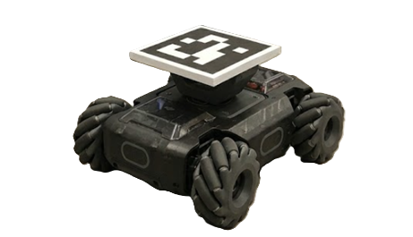
Challenge Two (cont’d)
Gameplay
The convoy will be launched into the drone cage and these robots will loiter for a period of time.
During this time, the team will launch the 3 HULA drones to search for these ground robots.
Other rules
During the assessment, 2 ground robots will be controlled by participants from other teams. The other 3 ground robots will travel on autonomously.
Teams will have to print the outputs from the Aruco marker on the ground robot to represent successful tagging (see image on bottom right).
Teams to inform the judge to indicate that the mission is completed.
Evaluation Criteria
Points will be awarded for successful and accurate tagging of the ground robots. Teams that complete the task in less time will earn more points.
) ) ) ) ) ) )
) ) )
Participants’ C2 Terminal
Convoy
5 x RoboMaster Ground Robots
) ) )
Enter
ID number

Slide 8
SCORING RUBRICS

Slide 9
Scoring Rubrics
 |  | Weightage
 |  | Uni | Pre-Uni
S/N | Challenge 1
1 | Number of landing pads detected (Image recognition) Number of landing points verified (Aruco marker) Timing | 15% | NA
2 | Accuracy of distance of obstacles/landing pads from reference point (using depth map) | 15%
 | Challenge 2
3 | Number of landings within hoop Timing | 30% | 44%
 | Challenge 2 (cont’d)
4 | Number of Aruco detections Timing | 30% | 44%
 | Bonus
5 | Completion of Counter UAS tech showcase | 4% | 4%
6 | Overall concept explanation | 7% | 8%
Judging Criteria
Teams will be scored based on their overall ranking
The ranking will be done based on the performance in each aspect
For S/N 1, 3 & 4, the priority will be in sequence (1, 2, 3).
To register the completion of Counter UAS tech showcase → (Refer to next slide)
) ) ) ) ) ) )
) ) )
) ) )

Slide 10
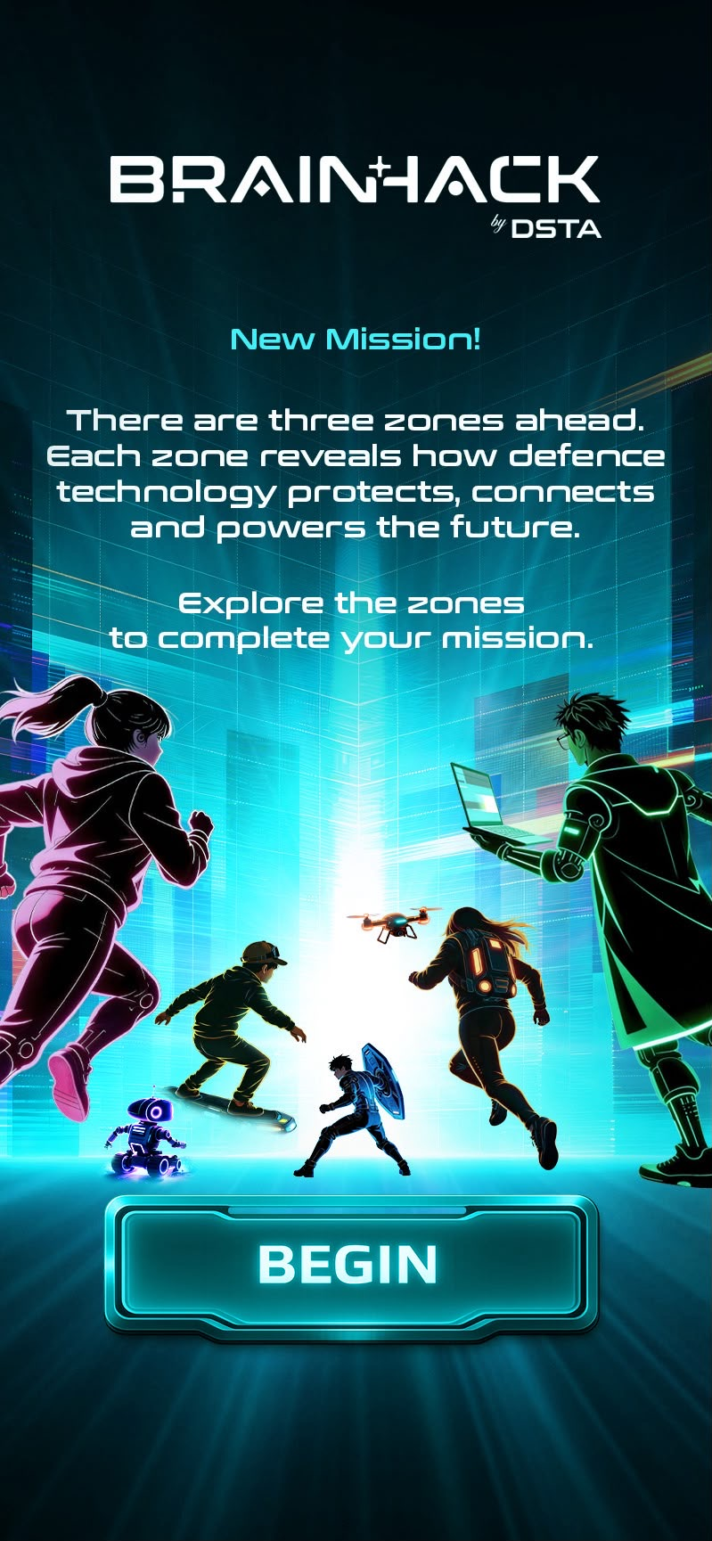
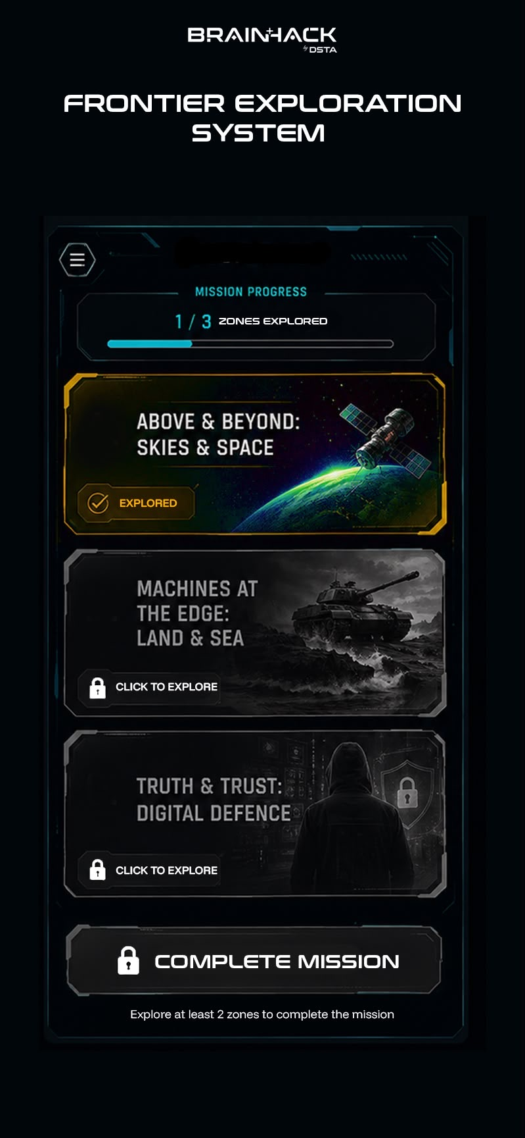
Bonus Points for CUAS Tech Showcase
Steps
Head to the Counter UAS Tech Showcase
Counter UAS booth is in the first zone – Above & Beyond: Skies & Space
Complete the task on the Brainhack Frontier Exploration System (see image)
Criteria
Snap a picture of the Drone at the Counter UAS booth
Screenshot of the zone explored page (see image)

Slide 11
SCHEDULE

Slide 12
Schedule
 | University Teams | Pre-University Teams
Day 1
0930 - 1030 | Briefing
1030 - 1200 | Testing #
1200 - 1300 | Lunch (no testing)
1300 - 1330 | Testing
1330 - 1430 | Prep for Challenge 1 * | Testing
1430 - 1800 | Challenge 1 | Testing
Day 2
0900 - 1230 | Testing
1230 - 1330 | Lunch (no testing)
1330 - 1600 | Challenge 2
) ) ) ) ) ) )
) ) )
) ) )
Note
# University teams can choose to test either the Hula or Mapping Drone before 1330H.
* No flying of the Mapping drone between 1330 – 1430H on day 1.

Slide 13
Order of Assessment (Challenge 1)
Sequence | Testing Team
1 | 4FINGERS
2 | AAA
3 | ARTIFICIALLYUNINTELLIGENT
4 | BOYD BUDDIES
5 | CALIBRUH
6 | FLYINGEXPLORERS
7 | GUIS
8 | HALLUCINATORS
9 | KAUSHIK
10 | MASTERBYTERS
11 | ROBO04
12 | ROBO05
13 | SARA
14 | SCRT3
15 | STD
16 | STINKIES
17 | YANG WEI INDUSTRIES

Slide 14
Order of Assessment (Challenge 2)
Sequence | Testing Team | Robomaster Opponent
1 | 4FINGERS | SARA
2 | AAA | SCRT3
3 | ARTIFICIALLYUNINTELLIGENT | STD
4 | BOYD BUDDIES | STINKIES
5 | CALIBRUH | YANG WEI INDUSTRIES
6 | FLYINGEXPLORERS | ROBO03
7 | GUIS | ROBO09
8 | HALLUCINATORS | ROBO11
9 | KAUSHIK | ROYAL RECRUITS 2
10 | MASTERBYTERS | SAMABEENHACKING
11 | ROBO04 | SO WHAT THE TEAM NAME GON BE
12 | ROBO05 | THE WIENERS
13 | SARA | UNTITLED
14 | SCRT3 | WANNABENGINEERS
15 | STD | ROBO05
16 | STINKIES | ROBO04
17 | YANG WEI INDUSTRIES | MASTERBYTERS
18 | ROBO03 | KAUSHIK
19 | ROBO09 | HALLUCINATORS
20 | ROBO11 | GUIS
21 | ROYAL RECRUITS 2 | FLYINGEXPLORERS
22 | SAMABEENHACKING | CALIBRUH
23 | SO WHAT THE TEAM NAME GON BE | BOYD BUDDIES
24 | THE WIENERS | ARTIFICIALLYUNINTELLIGENT
25 | UNTITLED | AAA
26 | WANNABENGINEERS | 4FINGERS

Slide 15
TESTING REGULATIONS

Slide 16
Testing Procedure
General Procedure
Get a Queue Number (links below).
Head to the waiting area when you are 3rd in line.
) ) ) ) ) ) )
Link to join the queue for Mapping Drone Cage (For University Teams)
Link to get queue number (To be updated)
Link to join the queue for Hula Drone Cage (For all Teams)
Link to get queue number (To be updated)

Slide 17
Testing Rules
Mapping Drone Cage (University only)
Each Team will be entitled to 5 mins to testing in the Drone Cage.
Hula Drone Cage (University & Pre-University)
At most 2 teams can test in 1 cage at any point of time.
There will be no limit to the total amount of time for testing.
However, each testing session will be limited to 5 mins.
There will be a cooldown of 20 mins after each testing (No re-queue for 20mins).
Other rules
There will be drones provided for testing at your tables. Strictly no flying is allowed outside of the cage.

Slide 18
Detailed Regulations
Testing operates on a First-Come-First-Serve (FCFS) queue system. No prior online booking of testing slots is required.
Teams may only join the queue when they are ready to test. When one team is testing, the next 2 team in the queue will be notified to report to the waiting area to prepare the drone.
Teams next in queue who do not report to the waiting area will be removed from the queue.
The testing timer starts when the team takes possession of the testing area and is cleared by the marshal to commence testing (i.e. drone take off); and ends when the drone lands.
The organiser reserves the right to adjust queue operations and utilise unused testing capacity to maximise the overall participation and testing opportunities.
Throughout the challenge, teams will not be given re-assessment attempts should the drone crash due to any reasons.
Teams who violate the testing regulations or ignore instructions provided by test marshals will face 1h no-testing penalty.
For mapping drone only
For the mapping drone, each Team is allocated a fixed amount of time for testing per day to ensure fair access to the testing facilities.
Teams may end a testing session before fully utilising their allocated testing allowance.
Any unused timing remains available to the team and may be utilised in subsequent testing sessions.
Teams with remaining testing allowance may re-join the back of the queue.
Unused testing allowance is non-transferable between teams.
No additional testing time will be granted if a team is unable to complete its planned activities within the testing allowance.

Slide 19
LOGISTICS PROVIDED

Slide 20
Logistics Provided to each Team
University
1 mapping drone (to be shared between 2 teams)
1 HULA drone (to be shared between 2 teams)
1 Sample landing pad
1 Sample Aruco pad
1 Laptop
Charger
Mouse
Pre-University
1 HULA drone
1 Sample landing pad
1 Sample Aruco pad
1 Laptop
Charger
Mouse

Slide 21
Logistics Provided to each Team
University
1 mapping drone (to be shared between 2 teams)
1 HULA drone (to be shared between 2 teams)
1 Sample landing pad
1 Sample Aruco pad
1 Laptop
Charger
Mouse
Pre-University
1 HULA drone
1 Sample landing pad
1 Sample Aruco pad
1 Laptop
Charger
Mouse

Slide 22
Logistics Provided to each Team
Sequence | Testing Team | HULA Drone No. | Mapping Drone No.
1 | 4FINGERS | 1,2 | 1,2
2 | AAA | 1,2 | 1,2
3 | ARTIFICIALLYUNINTELLIGENT | 3,4 | 3,4
4 | BOYD BUDDIES | 3.4 | 3.4
5 | CALIBRUH | 5,6 | 5,6
6 | FLYINGEXPLORERS | 5,6 | 5,6
7 | GUIS | 7,8 | 7,8
8 | HALLUCINATORS | 7,8 | 7,8
9 | KAUSHIK | 9,10 | 9,10
10 | MASTERBYTERS | 9,10 | 9,10
11 | ROBO04 | 11,12 | 11,12
12 | ROBO05 | 11,12 | 11,12
13 | SARA | 13,14 | 13,14
14 | SCRT3 | 13,14 | 13,14
15 | STD | 15,16,17 | 15,16,17
16 | STINKIES | 15,16,17 | 15,16,17
17 | YANG WEI INDUSTRIES | 15,16,17 | 15,16,17
18 | ROBO03 | 18 | NA
19 | ROBO09 | 19 | NA
20 | ROBO11 | 20 | NA
21 | ROYAL RECRUITS 2 | 21 | NA
22 | SAMABEENHACKING | 22 | NA
23 | SO WHAT THE TEAM NAME GON BE | 23 | NA
24 | THE WIENERS | 24 | NA
25 | UNTITLED | 25 | NA
26 | WANNABENGINEERS | 26 | NA

Slide 23
PRIZES

Slide 24
Competition Prize Awards
Pre-University Category
1st Place: $1,800
2nd Place: $1,300
3rd Place: $900
University Category
1st Place: $1,800
2nd Place: $1,300
3rd Place: $900

Slide 25
THANK YOU

